Slide 1

RUNGTA COLLEGE OF DENTAL SCIENCES & RESEARCH
TITLE OF THE TOPIC: MICROBIOLOGY IN ENDODONTICS
DEPARTMENT OF CONSERVATIVE DENTISTRY AND ENDODONTICS

Slide 2
Specific learning Objectives
At the end of this presentation the learner is expected to know
Core areas* H | Domain ** | Category #
Routes of microorganism, Microrganism associated with root canal infection | Cognitive | Must know
Intraradicular infection, extraradicular infection | Psychomotor | Nice to know
Methods of identification of microbes | Affective | Desire to know
*Subtopic of importance
** Cognitive, Psychomotor or Affective
# Must know , Nice to know & Desire to know

Slide 3
TABLE OF CONTENT:
INTRODUCTION
ROUTES OF MICROORGANISM INGRESS
MICROORGANISMS FOUND IN ROOT CANALS ASSOCIATED WITH ENDODONTIC INFECTIONS
INTRARADICULAR INFECTION
EXTRARADICULAR INFECTION
METHODS FOR IDENTIFICATION OF MICROBES

Slide 4
EXTRARADICULAR INFECTIONS

Slide 5
Apical periodontitis lesions are formed in response to intraradicular infection
Comprise an effective barrier against spread of infection to alv. bone and other body sites
In some specific circumstances, m.org. can overcome this barrier and establish an extraradicular infection.
The most common form of extraradicular inf → acute apical abscess.

Slide 6
Characterized by purulent inflammation in response to massive egress
This condition encompasses the establishment of m.org., either by adherence to apical external root surface or by formation of cohesive actinomycotic colonies within the body of inflammatory lesion
Extraradicular m.org. are one of the etiologic factor for persistence of api.perio in spite of diligent RCT

Slide 7
Most oral m.org → oppertunistic pathogens
few have ability to challenge & overcome host defence → establish extraradicular inf
Currently recognized → some Actinomyces spp and Propionibacterium propionicum → ability to participate in extraradicular inf and cause apical actinomycosis

Slide 8
Treponema spp, Porphyromonas endodontalis, Porphyromonas gingivalis, Tennerela forsythia, Prevotella spp amd Fusobacterium nucleatum → persistent chr.api.perio.
Dependent or independent of intraradicular inf
Incidence of independent in untreated is low

Slide 9
Even is RC treated → high rate of healing → following retreatment
Thus , most of the extraradicular infection observed in root filled tooth could have been fostered by intraradicular infection.

Slide 10
Following situations may permit intraradicular bacteria to reach periapical tissue and establish extraradicular infection.
A result of direct advance
Due to bacterial persistance --- after remission
A sequel to apical extrusion
Virulence and quantity of involved bact + host ability to deal with inf → whether an extraradicular infection will develop

Slide 11
ENTEROCOCCUS
Genus of Gram +ve facultative anaerobic coccoid bacteria
Until 1984 were classified as Group D streptococci
Can grow at temp ranging 10-45°C

Slide 12
E. faecalis and E.faecium -- most common Enteroccocal sp found in human
One of the common bloodstream nosocomial pathogen
UTI, abdominal pelvic inf, infective endocarditis, prosthetic joint inf, etc
Multiple antibiotic resistance by E.faecalis is major factor in its prominanace in nosocomial inf

Slide 13
Oral cavity is a potential reservior of E.faecalis for entry in root canal
E.faecalis was detected more in tongue(43%) than in gingival sulcus (14%), oral rinse(10%) and root canal samples(10%)
Pt with gingivitis/peridontitis > normal periodontium

Slide 14
Prevalence of Enterococci in root filled teeth
E.faecalis has been repeatedly identified as the sp most commonly recovered from root canals of teeth with failed RCT and persistant inf
The prevalance rates of E.faecalis in RC inf reported in different studies varies widely

Slide 15
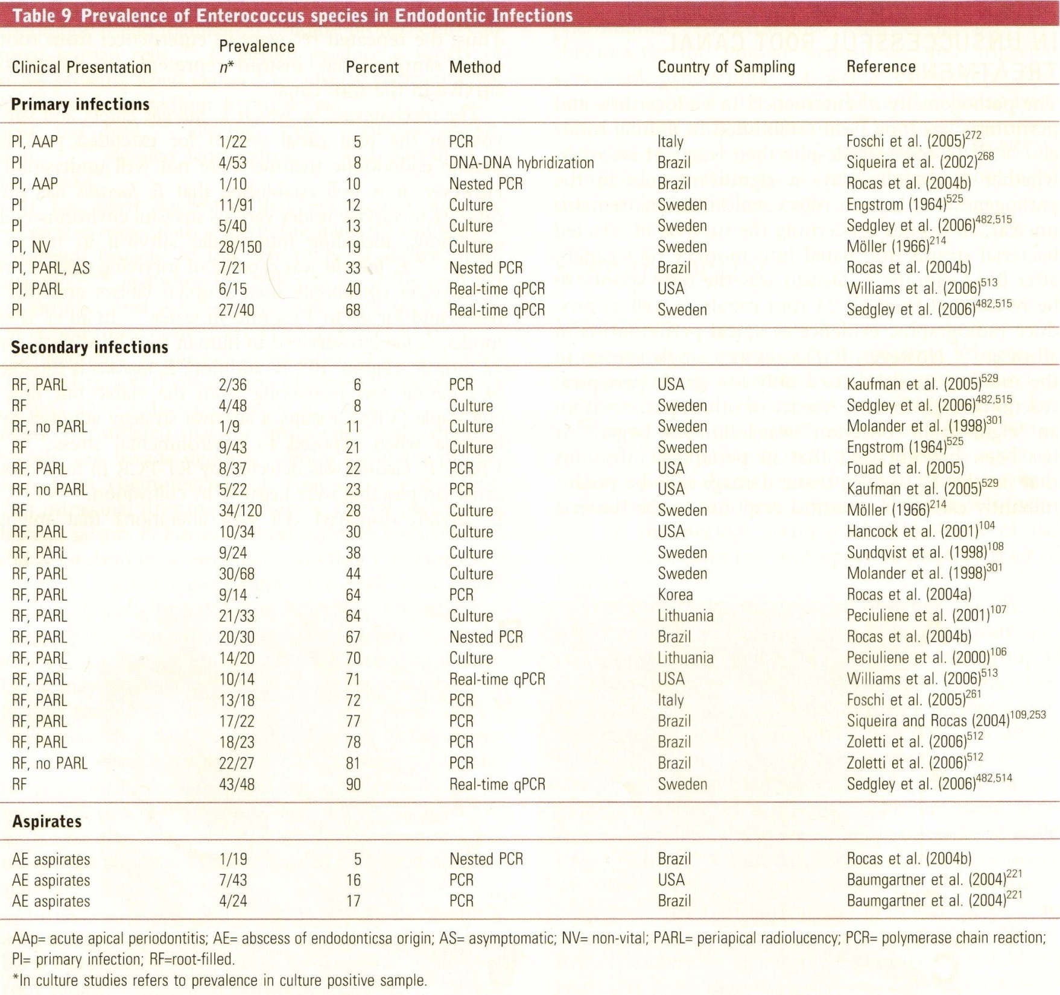

Slide 16
Potential role of Enterococci in unsuccessful RCT
Despite their frequent recovery, its role in pathogenesis of Rcinf is unclear
Hypothesized → periapical infections that involve E.faecalis, tissue damage may be predominantly caused by the host response to the bacteria rather than direct damage from bacterial products

Slide 17
The mechanism by which E.feacalis enters and survive in rc for extended periods despite endo treat are not well understood.
Capacity to survive under various stressful environmental conditions.
In an ex vivo model, it survived in human root filled teeth for 12 months.
Capable of entering and recovering from the viable but non culturable state.

Slide 18
Displays cell wall alteration that might provide protection under unfavorable environmental conditions.
Produces variety of stress protein when exposed to adverse enviromental factors such as NaOCl, salt, bile salts, acid, heat, alkaline stress, glucose starvation, elevated temp,

Slide 19
Enterococci may persist in root canal undergoing standard endo treat is because of its
low sensitivity to antimicrobial agents,
ability to resist the high pH of antimicrobial agents commonly used

Slide 20
In presence of human serum, bounds better to collogen that S.mutans/S.gordonii
Coaggregation interaction occuring in bio films may provide an effective mean by which E.faecalis remains in root canal
Furthermore this biofilms exhibit ability to calcify→facilitates stability

Slide 21
Virulence factors with the potential to promote adaptation and survival in different environment includes:
Enterococcus surface protein(Esp)
Collagen binding protein
Aggregation substance
Factor that enable secreation of proteases (eg: gelatinase)
Toxins (eg. cytolysin)
This factors helps in binding to dentin as well as promote resistance to host defence

Slide 22
STREPTOCOCCUS
Genus Gram +ve, facultative anarobic coccoid bacteria
Non motile 1mm in diameter, can form capsule
Part of normal commensal microbiota of the mouth, skin, intestine, upper respiratory tract
Notes:
Related to

Slide 23
S.viridans – infective endocarditis
S. mutans- dental caries
S. pyogens- bacteremia, pharyngitis, rheumatic fever
and acute glomerulonephritis.
S. gordonii- infective endocarditis, early colonizer of
dental plaque

Slide 24
prevalence
Studies have shown that in teeth with clinical and radiographical signs of apical periodontitis, streptococci survived following rct, although less than enterococci.
In this most frequently isolated → S. gordonii , S.oralis.
S.intermedius, S.anginosus, S.oralis and S.gordonii → strong producer of extracellular protein → play imp role in post treat api.perio
Rarely resistant to antimicrobial agents

Slide 25
Potential role
In root filled teeth with persisting periapical lesion, significant positive association were observed between sinus tract – streptococcus sp and coronally unsealed teeth – streptococcus sp

Slide 26
The virulence factors are diverse and are often proteins a/w cell walls
LTA are present on the cell surface of most oral streptococci and is important virulence factor
LTA can bind to cell surface receptors → induce the release of proinlammatory cytokines

Slide 27
Also have a large range of cell surface adhesins→ facilitates binding to bacterial cells, epithelial cells and dentin
May recognize components present within dentinal tubules(collagen type 1)
This stimulates bacterial adhesion and intratubular growth
S.gordonii – midroot+cervical- upto 200micron
-apical –upto 60 microns

Slide 28
ACTINOMYCES
Non spore forming Gram +ve bacteria.
Many sp. are commensals in oral cavity but can become oppertunistic pathogens
Occasionally causes actinomycosis characterized by formation of abscess in mouth, lungs or GIT
Happonen et al(1983) reported involvement of A.israelli in osteoradionecrosis of the jaws

Slide 29
Implicated in root caries
Sp involved are A.israelii, A. naeslundii, A.gerencseriae, A.odontolyticus and A.georgiae
In germ free rats, A.israelii was shown to cause root surface caries and invasion of pulp tissue
In pt with periodontally affected non vital teeth, the periodontal pocket may provide source of actinomycosis

Slide 30
prevalence
Predominant in the apical 5mm of root canals of extracted teeth with carious pulp exposure and periapical lesion
The presence in periapical cyst has also been reported
Strains of A.radicidentis were first found in root canal and periapical abscess from pt persisting infection following endo treat

Slide 31
Potential role
Actinomyces can be fimbriated/non fimbriated
This may be involved in coaggregation interaction
Has been speculated that this contribute to pathogenicity of A.israelii

Slide 32
Contribute to modulation of their adhesion and coaggregation properties
Studies have shown that the pathogenecity of A.israelii is due to the ability of the branching filamentous organisms to evade elimination by host phagocytes

Slide 33
Teaching Materials
Endodontic practices - Grossman
Pathways of pulp – Cohen
Textbook of Endodontics – Nisha Garg
Endodontics - Ingle

Slide 34
TAKE HOME MESSEGE/ FOR THE TOPIC COVERED (SUMMARY)
Infection of the root canal is not a random event.
The type and mix of the microbial flora develop in response to the surrounding environment. Microorganisms that establish in the untreated root canal experience an environment of nutritional diversity.
In contrast, well-filled root canal offers the microbial flora a small, dry, nutritionally limited space.
Thus, we should obtain a better understanding of the characteristics and properties of bacteria and their biofilms along with the environmental changes, to enhance success.

Slide 35
Question & Answer Session
What is a role of Enterococci in unsuccessful RCT?
Characteristic of E. faecalis?

Slide 36
REFERENCES
Endodontic practices - Grossman
Pathways of pulp – Cohen
Textbook of Endodontics – Nisha Garg
Endodontics - Ingle

Slide 37
THANK YOU

